Slide 1

Geometry
Unit 7, Lesson 3 Defining Tangent Volume 1, pg. 381

Slide 2


Benchmarks
MA.912.T.1.1
Define trigonometric ratios for acute angles in right triangles.
MA.912.T.1.2
Solve mathematical and real-world problems involving right triangles using trigonometric ratios and the Pythagorean Theorem.
volume 1, pg. 381

Slide 3
Integrated Mathematical Thinking and Reasoning Standards
MA.K12.MTR.1.1 Actively participate in effortful learning both individually and collectively.
MA.K12.MTR.2.1 Demonstrate understanding by representing problems in multiple ways.
MA.K12.MTR.4.1 Engage in discussions that reflect on the mathematical thinking of self and others.
MA.K12.MTR.5.1 Use patterns and structure to help understand and connect mathematical concepts.
MA.K12.MTR.6.1 Assess the reasonableness of solutions.
volume 1, pg. 381

Slide 4

Learning Target
I can use the ratios of sine and cosine to define the tangent ratio.
volume 1, pg. 381

Slide 5

Warm-Up
volume 1, pg. 382

Slide 6
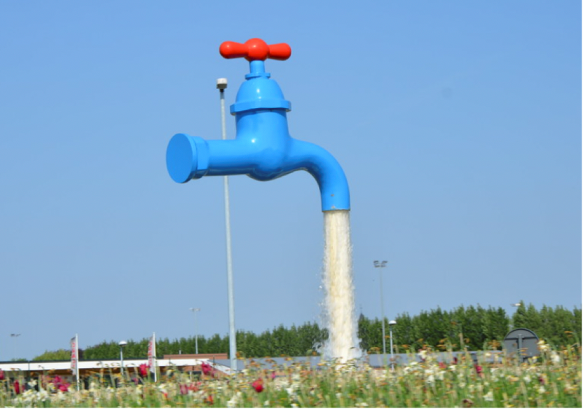
7.3.1 Warm-Up: Notice and Wonder
What do you wonder?
What do you notice?
volume 1, pg. 382

Slide 7

Exploration
volume 1, pg. 382

Slide 8

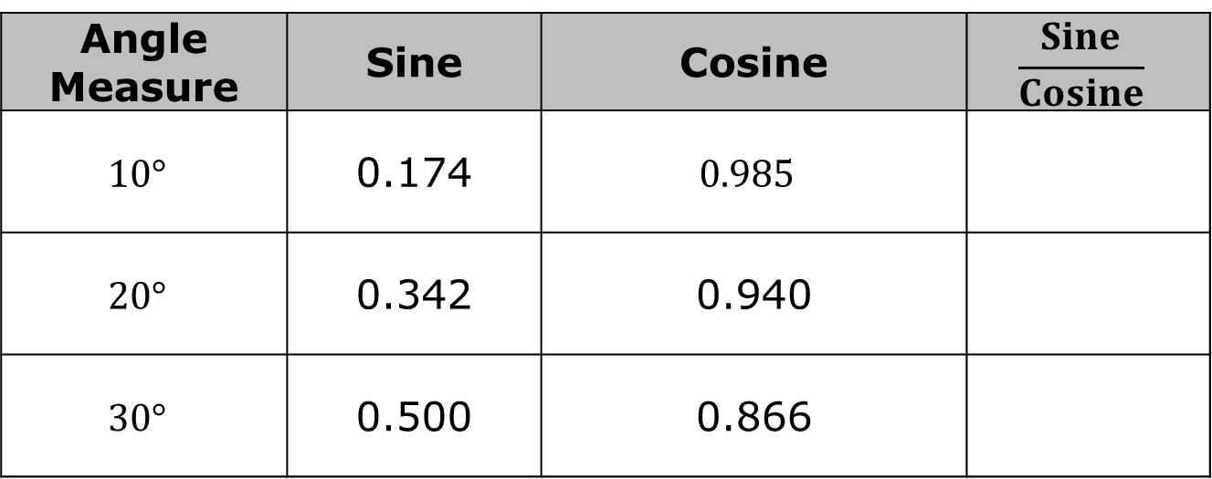
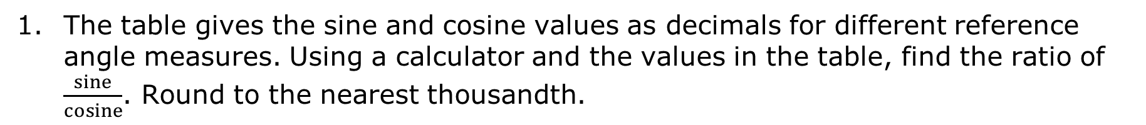
7.3.2 Exploration: Relating Sine, Cosine, and Tangent
The table gives the sine and cosine values as decimals for different reference angle measures. Using a calculator and the values in the table, find the ratio of $\frac{sine}{cosine}$. Round to the nearest thousandth.
Angle Measure | Sine | Cosine | $$\frac{Sine}{Cosine}$$
$$10°$$ | 0.174 | $$0.985$$
$$20°$$ | 0.342 | 0.940
$$30°$$ | 0.500 | 0.866
volume 1, pg. 382

Slide 9
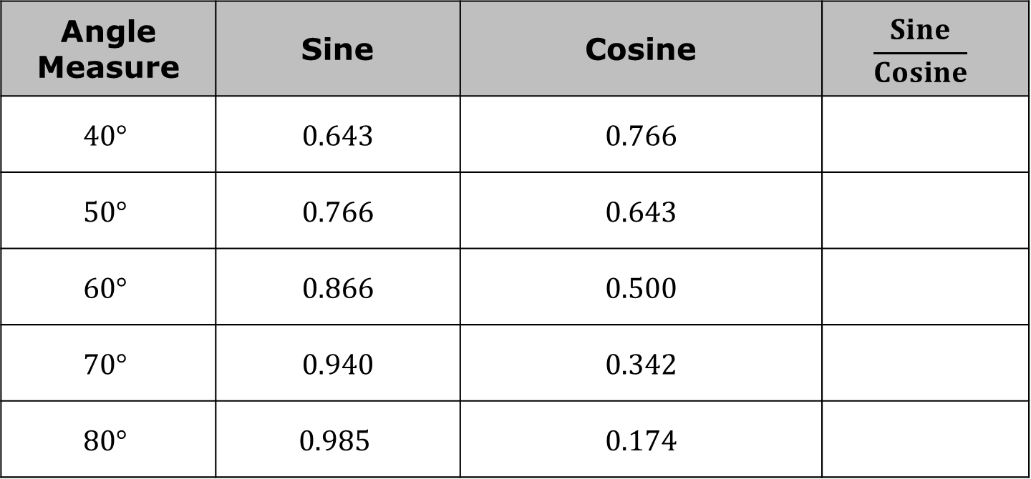
Angle Measure | Sine | Cosine | $$\frac{Sine}{Cosine}$$
$$40°$$ | 0.643 | 0.766
$$50°$$ | 0.766 | 0.643
$$60°$$ | 0.866 | 0.500
$$70°$$ | 0.940 | 0.342
$$80°$$ | $$\text{0.9}\text{85}$$ | 0.174
volume 1, pg. 382

Slide 10
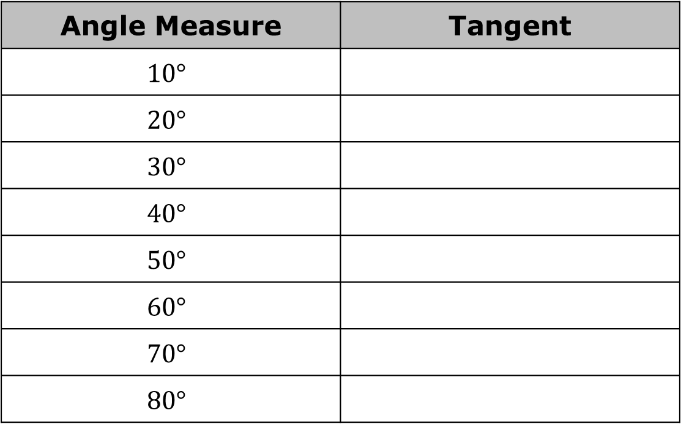
Use a calculator to find the tangent ($tan$) of each reference angle.
Angle Measure | Tangent
$$10°$$
$$20°$$
$$30°$$
$$40°$$
$$50°$$
$$60°$$
$$70°$$
$$80°$$
volume 1, pg. 383

Slide 11
Write down one notice statement and one wonder statement about the values of $\frac{sine}{cosine}$ from the first table and the values of $tan$ from the second table.
Notice | Wonder
volume 1, pg. 383

Slide 12
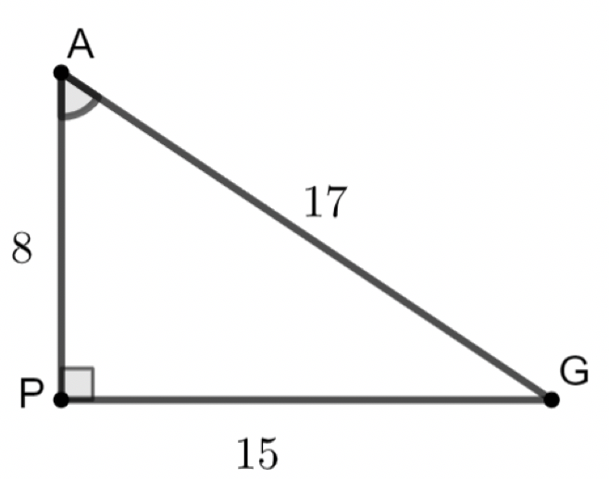
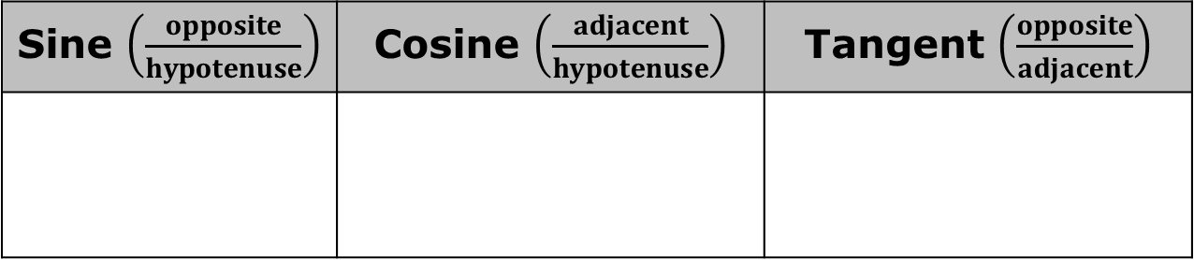

$ΔAPG$ is shown, where $m∠APG=90°, AP=8, PG=15$, and $AG=17$.
Using $∠PAG$ as the reference angle, complete the table.
Sine $\left(\frac{opposite}{hypotenuse}\right)$ | Cosine $\left(\frac{adjacent}{hypotenuse}\right)$ | Tangent $\left(\frac{opposite}{adjacent}\right)$
volume 1, pg. 383

Slide 13
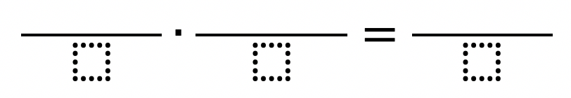
Multiply the sine and the cosine ratios from the table.
volume 1, pg. 383

Slide 14
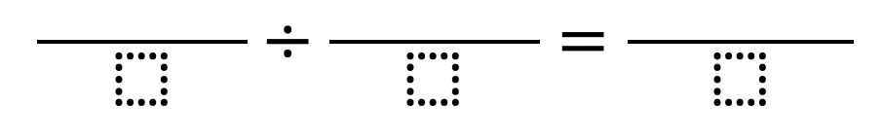
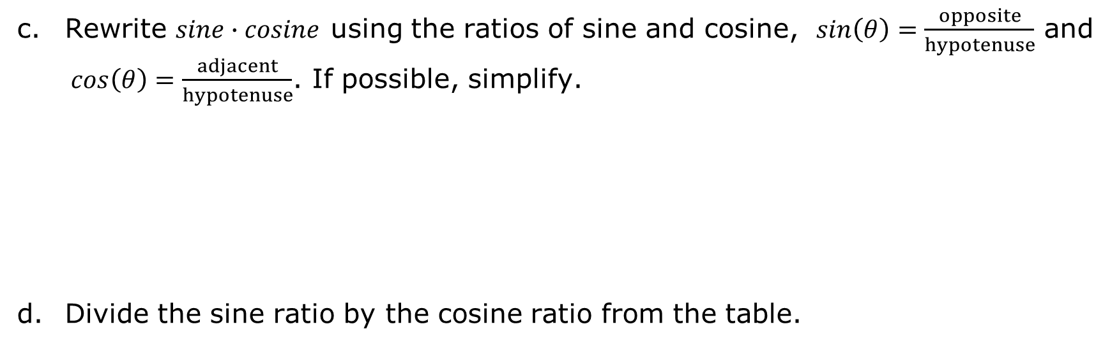
Rewrite $sine∙cosine$ using the ratios of sine and cosine, $sin\left(θ\right)=\frac{opposite}{hypotenuse}$ and $cos\left(θ\right)=\frac{adjacent}{hypotenuse}$. If possible, simplify.
Divide the sine ratio by the cosine ratio from the table.
volume 1, pg. 384

Slide 15
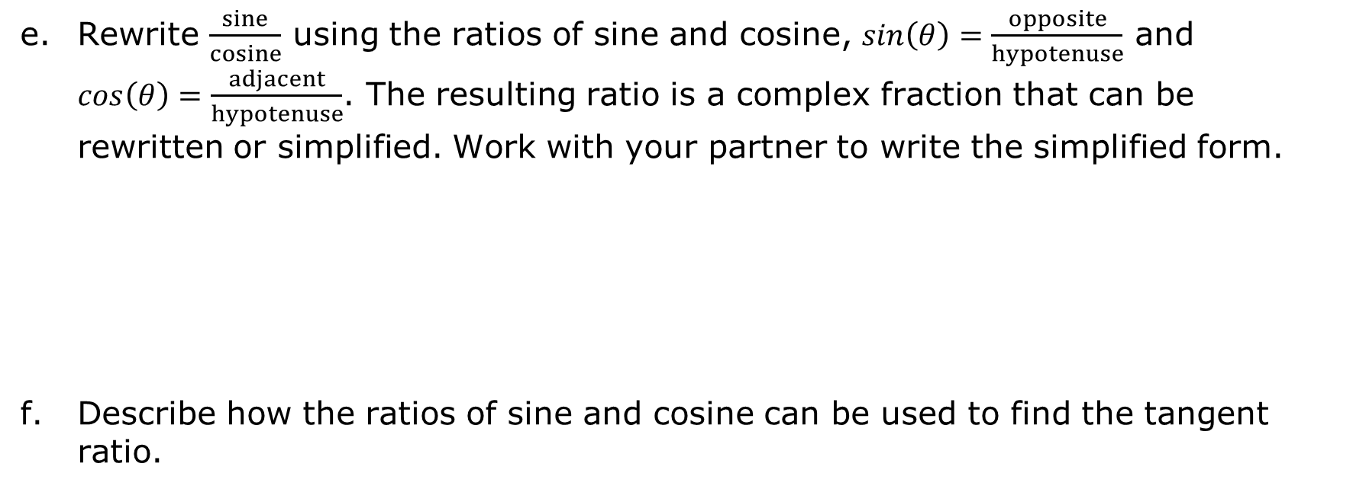
Rewrite $\frac{sine}{cosine}$ using the ratios of sine and cosine, $sin\left(θ\right)=\frac{opposite}{hypotenuse}$ and $cos\left(θ\right)=\frac{adjacent}{hypotenuse}$. The resulting ratio is a complex fraction that can be rewritten or simplified. Work with your partner to write the simplified form.
Describe how the ratios of sine and cosine can be used to find the tangent ratio.
volume 1, pg. 384

Slide 16

Guided Instruction
volume 1, pg. 384

Slide 17

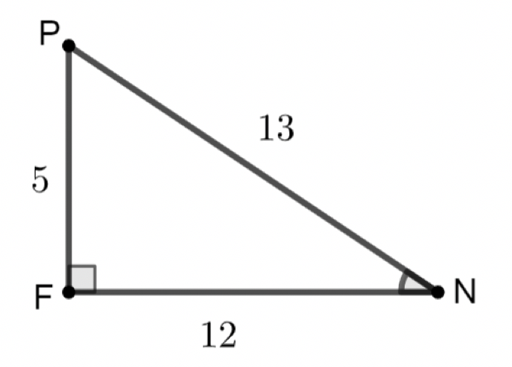
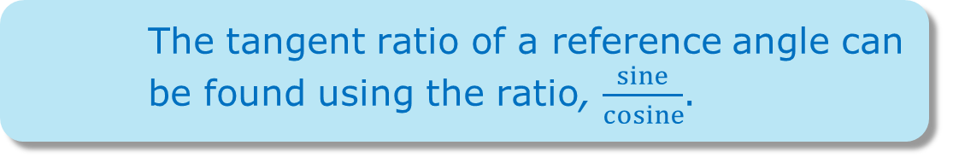
7.3.3 Guided Instruction: Determining Trigonometric Ratios
The tangent ratio of a reference angle can be found using the ratio, $\frac{sine}{cosine}$.
$∆PFN$ is shown, where $m∠PFN=90°, PF=5, FN=12$, and $PN=13$.
volume 1, pg. 384

Slide 18
Using $∠FNP$ as the reference angle, find the three ratios.
Cosine | Sine | Tangent
volume 1, pg. 384

Slide 19
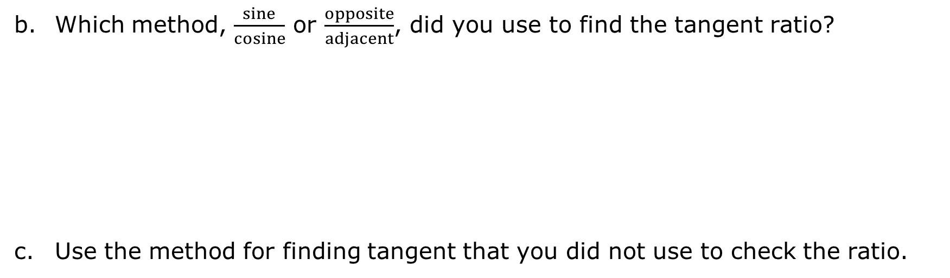
Which method, $\frac{sine}{cosine}$ or $\frac{opposite}{adjacent}$, did you use to find the tangent ratio?
Use the method for finding tangent that you did not use to check the ratio.
volume 1, pg. 385

Slide 20
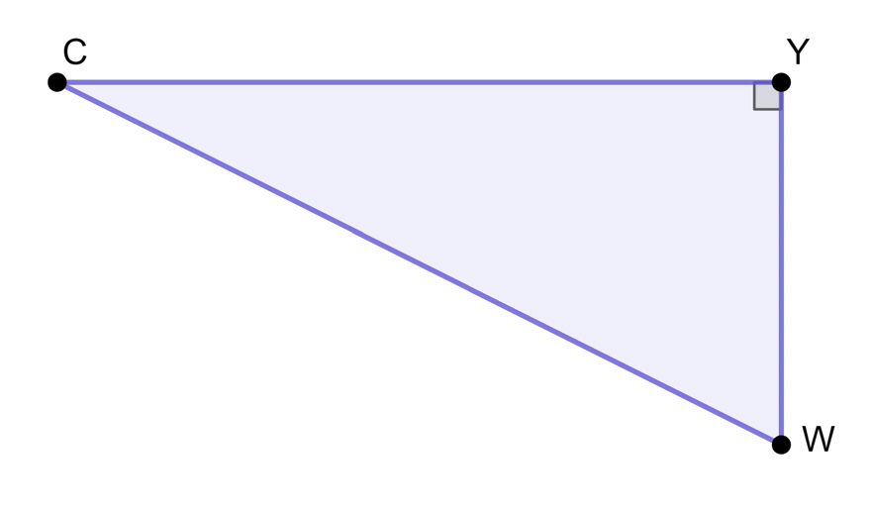
$∆CYW$ is shown, where $CY=\sqrt{98}$ and $YW=\sqrt{28}$.
volume 1, pg. 385

Slide 21
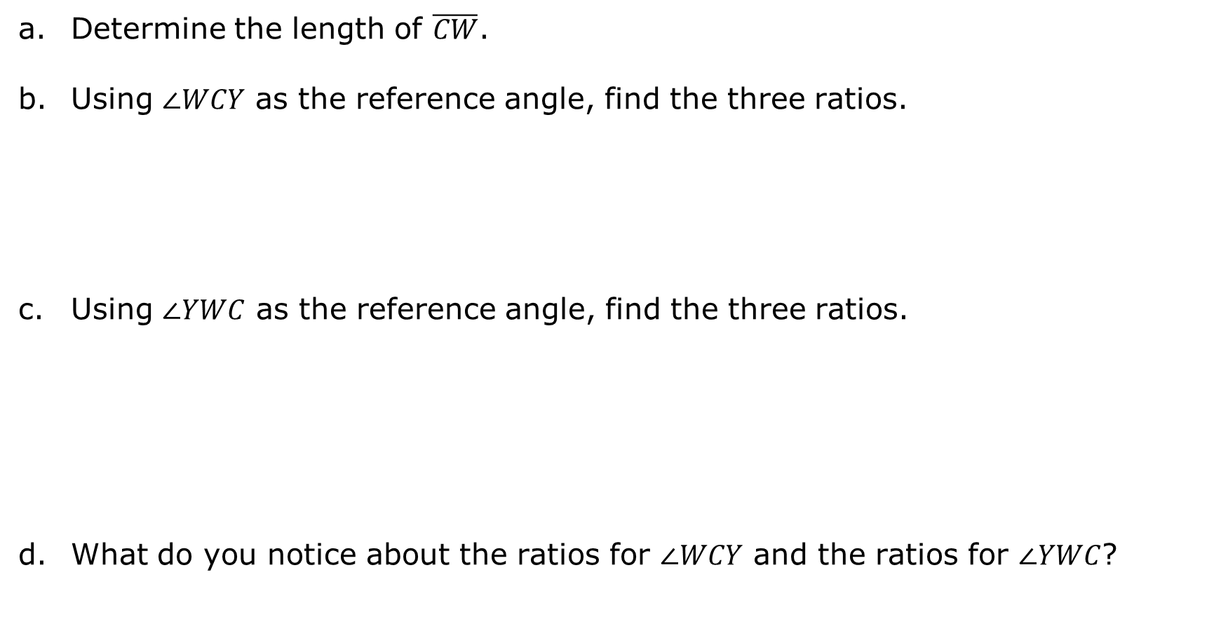
Determine the length of $\overline{CW}$.
Using $∠WCY$ as the reference angle, find the three ratios.
Using $∠YWC$ as the reference angle, find the three ratios.
What do you notice about the ratios for $∠WCY$ and the ratios for $∠YWC$?
Cosine | Sine | Tangent
Cosine | Sine | Tangent
volume 1, pg. 385

Slide 22

Guided Practice
volume 1, pg. 386

Slide 23

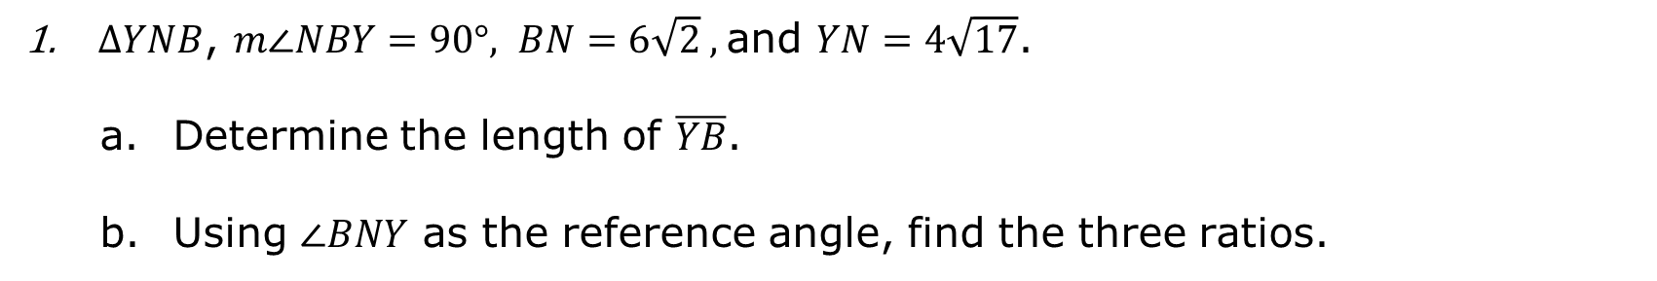
7.3.4 Guided Practice: Trigonometric Ratios
$∆YNB$, $m∠NBY=90°, BN=6\sqrt{2} ,$and $YN=4\sqrt{17}$.
Determine the length of $\overline{YB}$.
Using $∠BNY$ as the reference angle, find the three ratios.
Cosine | Sine | Tangent
volume 1, pg. 386

Slide 24
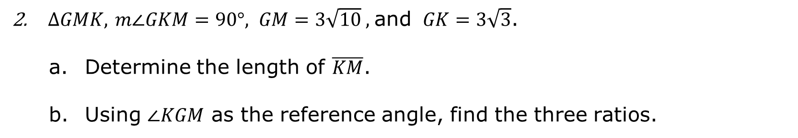
$∆GMK,$ $m∠GKM=90°, GM=3\sqrt{10} ,$and $GK=3\sqrt{3}$.
Determine the length of $\overline{KM}$.
Using $∠KGM$ as the reference angle, find the three ratios.
Cosine | Sine | Tangent
volume 1, pg. 386

Slide 25

Wrap-Up
volume 1, pg. 387

Slide 26
7.3.5 Wrap-Up: Cool Down
Write a short note to a friend who missed today’s class summarizing what you learned.
volume 1, pg. 387

